Slide 1


# Business Objective:
To predict a model for churn probability in a telecom Company taking into account various customer features.
Ms. Patrali Ray
Mister. Rahul Govindaraju
Jain James
Vikrant Singh Guleria
Miss. Sannidhi CS
Sunil Dharmaraj More

Slide 2

Data Set Details
The Data Set has 19 columns and 3333 rows with no missing values
The dataset consists of only numerical Data without any duplicate values.
These are the explanations for variables:
Account_length: the tenure of the customer account.
Voice Mail Plan: Indicates if the said customer is in any specific plan or not.
Voice Mail Messages: Total messages sent by customer.
Day mins: Total day minutes consumed by the customer in a month.
Eve mins: Total Evening minutes consumed by the customer in a month.
Night Mins: Total Night minutes consumed by the customer in a month.
Internations Mins: Total time spent on international calls.
Customer service calls: Number of times customer has called customer care.
International plan: whether customer has taken any international plan or not.
Day Calls: Number of day calls in a month.
Day Charge: total day call charge in a month.
Evening calls: Number of evening calls in a month.
Evening charge: total evening call charge in a month.
Night calls: Number of night calls in a month.
Night Charge: total night call charge in a month.
International calls: Number of international calls made by the customer in a month.
International charge: Total international call charge in a month.
Total Charge: Total monthly charges of the customer.

Slide 3
Data Insights
 | account_length | voice_mail_plan | voice_mail_messages | day_mins | evening_mins | night_mins | international_mins | customer_service_calls | international_plan | day_calls | day_charge | evening_calls | evening_charge | night_calls | night_charge | international_calls | international_charge | total_charge | churn
count | 3333 | 3333 | 3333 | 3333 | 3333 | 3333 | 3333 | 3333 | 3333 | 3333 | 3333 | 3333 | 3333 | 3333 | 3333 | 3333 | 3333 | 3333 | 3333
mean | 101.06 | 0.28 | 8.10 | 179.78 | 200.98 | 200.87 | 10.24 | 1.56 | 0.10 | 100.44 | 30.56 | 100.11 | 17.08 | 100.11 | 9.04 | 4.48 | 2.76 | 59.45 | 0.14
std | 39.82 | 0.45 | 13.69 | 54.47 | 50.71 | 50.57 | 2.79 | 1.32 | 0.30 | 20.07 | 9.26 | 19.92 | 4.31 | 19.57 | 2.28 | 2.46 | 0.75 | 10.50 | 0.35
min | 1 | 0 | 0 | 0 | 0 | 23.2 | 0 | 0 | 0 | 0 | 0 | 0 | 0 | 33 | 1.04 | 0 | 0 | 22.93 | 0
25% | 74 | 0 | 0 | 143.7 | 166.6 | 167 | 8.5 | 1 | 0 | 87 | 24.43 | 87 | 14.16 | 87 | 7.52 | 3 | 2.3 | 52.38 | 0
50% | 101 | 0 | 0 | 179.4 | 201.4 | 201.2 | 10.3 | 1 | 0 | 101 | 30.5 | 100 | 17.12 | 100 | 9.05 | 4 | 2.78 | 59.47 | 0
75% | 127 | 1 | 20 | 216.4 | 235.3 | 235.3 | 12.1 | 2 | 0 | 114 | 36.79 | 114 | 20 | 113 | 10.59 | 6 | 3.27 | 66.48 | 0
max | 243 | 1 | 51 | 350.8 | 363.7 | 395 | 20 | 9 | 1 | 165 | 59.64 | 170 | 30.91 | 175 | 17.77 | 20 | 5.4 | 96.15 | 1
Below are some of the insights:
Avg acc length is 101, the range is between 1 to 243, 75% of the customers have tenure less than 127 days.
Voice_mail_plan & international_plan are actually categorical hence the 25%-50%-75% distribution is not proper.
Avg total_charge is 59.44 whereas 25% customers pay more than 66.48 per month.
It is noticeable that voice_mail_messages,day_mins,evening_mins,day_calls,evening_calls,international_calls, the minimum range is '0' which signifies that there are customers who are not utilizing their plan effectively.

Slide 4
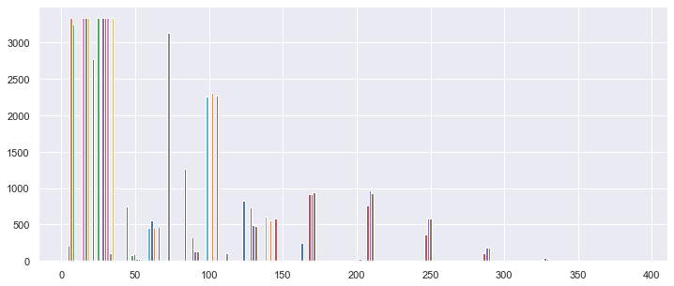
Distribution of data
Insights:
Data is not normally distributed.
Data is positively skewed.

Slide 5
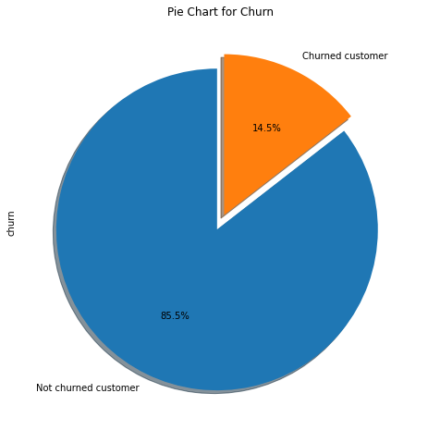
Analyzing The Dependent Variabe i.e ‘churn’
Data is highly imbalanced, ratio = 86:14, So we analyzed the data with other features while taking the target values separately to get some insights.

Slide 6
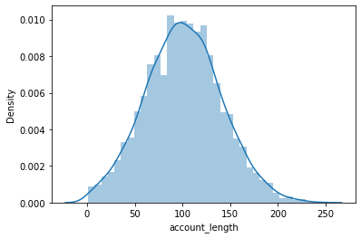
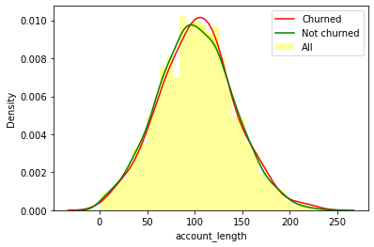
Analyzing Account Length column
After analyzing various aspects of the "account length" column we didn't find any significant insight. so we aren't able to build any connection to churn as of now. We will further analyze other features.

Slide 7
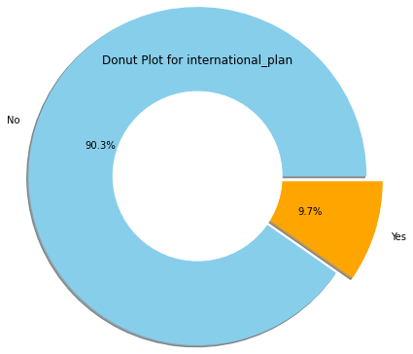
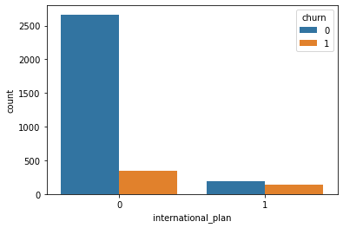
Analyzing "International Plan" column
Data Insights:
There are 3010 customers who dont have a international plan.
There are 323 customers who have a international plan.
Among those who have a international plan 42.4 % people churn, whereas among those who dont have a international plan only 11.4 % people churn.
So basically customers who have subscribed to International plans are churning in big numbers presumably due to issues like connectivity issues or high call charges.

Slide 8
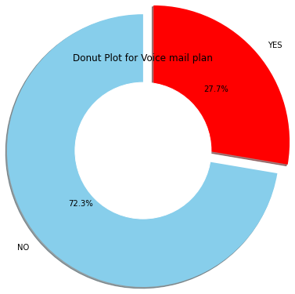
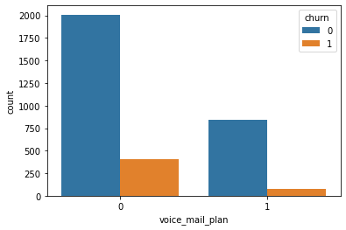
Analyzing "Voice Mail Plan" column
Data Insights
Only 28% Customers have subscribed to voice mail plan

Slide 9
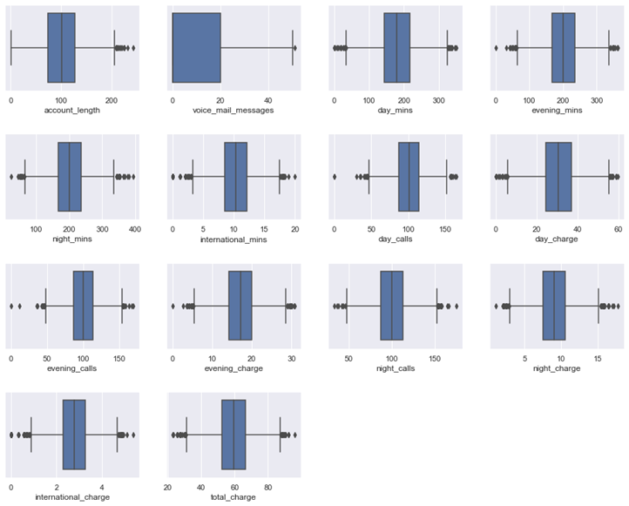
Boxplot Visualization for Checking Outliers for numerical columns
Feature | is Exist Outlier | Total Outliers | Churned
account_length | TRUE | 18 | 5
voice_mail_messages | TRUE | 1 | 0
day_mins | TRUE | 25 | 12
evening_mins | TRUE | 24 | 5
night_mins | TRUE | 30 | 2
international_mins | TRUE | 46 | 5
day_calls | TRUE | 23 | 7
day_charge | TRUE | 25 | 12
evening_calls | TRUE | 20 | 2
evening_charge | TRUE | 24 | 5
night_calls | TRUE | 22 | 1
night_charge | TRUE | 30 | 2
international_charge | TRUE | 49 | 6
total_charge | TRUE | 27 | 16

Slide 10
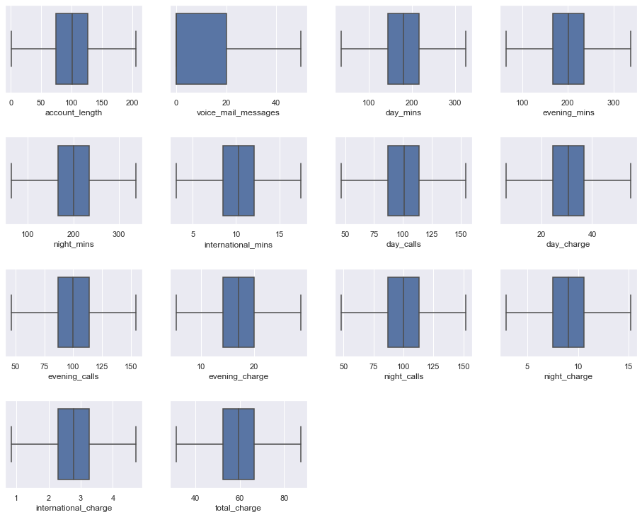
Boxplot visualization after treating outliers
Feature | is Exist Outlier | Total Outliers
account_length | FALSE | 0
voice_mail_messages | FALSE | 0
day_mins | FALSE | 0
evening_mins | FALSE | 0
night_mins | FALSE | 0
international_mins | FALSE | 0
day_calls | FALSE | 0
day_charge | FALSE | 0
evening_calls | FALSE | 0
evening_charge | FALSE | 0
night_calls | FALSE | 0
night_charge | FALSE | 0
international_charge | FALSE | 0
total_charge | FALSE | 0

Slide 11
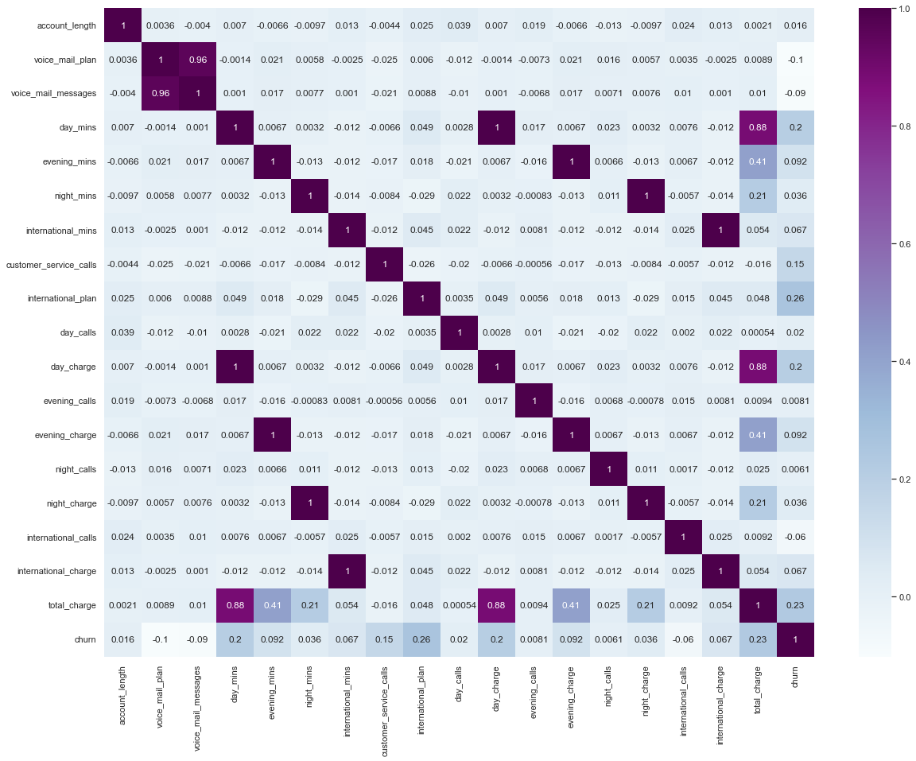
Checking Correlation
Most Positive Correlations:
international_plan | 0.2599
total_charge | 0.2315
day_charge | 0.2048
day_mins | 0.2048
customer_service_calls | 0.1524
evening_mins | 0.0921
evening_charge | 0.0921
international_charge | 0.0666
international_mins | 0.0666
night_charge | 0.0362
night_mins | 0.0362
day_calls | 0.0198
account_length | 0.0163
evening_calls | 0.0081
night_calls | 0.0061
dtype: float64
Most Negative Correlations:
international_calls | -0.06
voice_mail_messages | -0.09
voice_mail_plan | -0.102

Slide 12
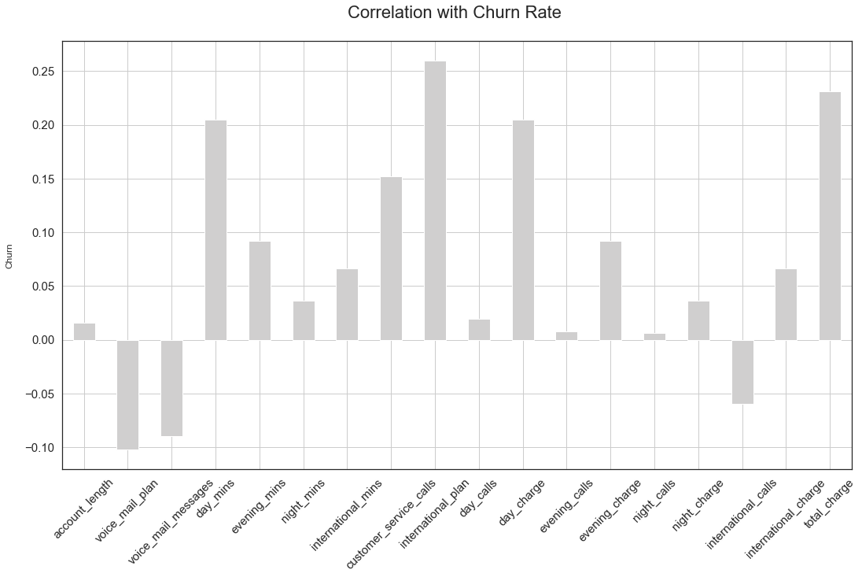
Data Insights:
Voice Mail plan and Voice mail messages are highly correlated.
Between day mins and day charge, evening mins and evening charge, night mins and night charge high correlation exists.
Day charge, evening charge and total charge have high correlation in between them.
Hence considering above factors we are dropping highly correlated columns viz. 'voice_mail_messages', 'day_charge', 'evening_charge', 'night_charge‘ and 'international_charge‘.

Slide 13
Top Feature Selection
Mutual Information Statistics Method
Annova-f Statistic Method
 | features | mutual_info_classif_scores
12 | total_charge | 0.105161
2 | day_mins | 0.055593
6 | customer_service_calls | 0.046106
7 | international_plan | 0.029763
8 | day_calls | 0.010675
1 | voice_mail_plan | 0.009489
11 | international_calls | 0.005856
3 | evening_mins | 0.002319
5 | international_mins | 0.002087
0 | account_length | 0.001926
4 | night_mins | 0.000138
9 | evening_calls | 0
10 | night_calls | 0
 | features | annova_f_scores
7 | international_plan | 241.206004
12 | total_charge | 188.546913
2 | day_mins | 145.810306
6 | customer_service_calls | 79.20912
1 | voice_mail_plan | 35.122944
3 | evening_mins | 28.501952
5 | international_mins | 14.820214
11 | international_calls | 11.848277
4 | night_mins | 4.364962
8 | day_calls | 1.308519
0 | account_length | 0.882581
9 | evening_calls | 0.219673
10 | night_calls | 0.124543
Top 5 relevent features:
international_plan
total_charge
day_mins
customer_service_calls
voice_mail_plan

Slide 14
Multicollinearity check
 | variables | VIF
12 | total_charge | 39571.45394
2 | day_mins | 11045.39525
3 | evening_mins | 3383.012924
4 | night_mins | 960.217392
5 | international_mins | 106.33832
10 | night_calls | 22.553537
9 | evening_calls | 22.346787
8 | day_calls | 22.210801
0 | account_length | 7.246295
11 | international_calls | 4.249229
6 | customer_service_calls | 2.377717
1 | voice_mail_plan | 1.381607
7 | international_plan | 1.115208
Since we are observing high multi collinearity, we are dropping columns with high VIF scores
Hence below are the retained columns with low VIF scores:
 | variables | VIF
4 | total_charge | 5.451551
3 | international_calls | 3.95409
1 | customer_service_calls | 2.302968
0 | voice_mail_plan | 1.371177
2 | international_plan | 1.110698

Slide 15
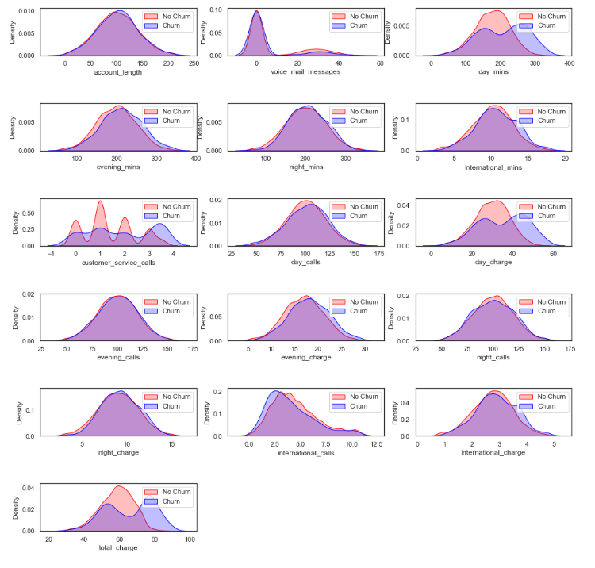
Density Plot
Most of the features are normally distributed

Slide 16
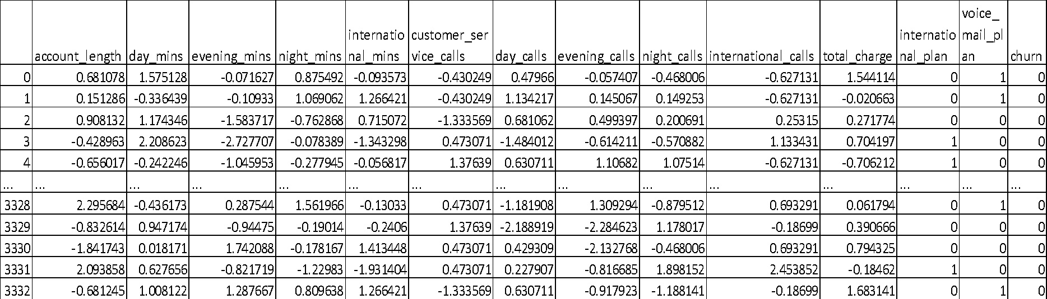
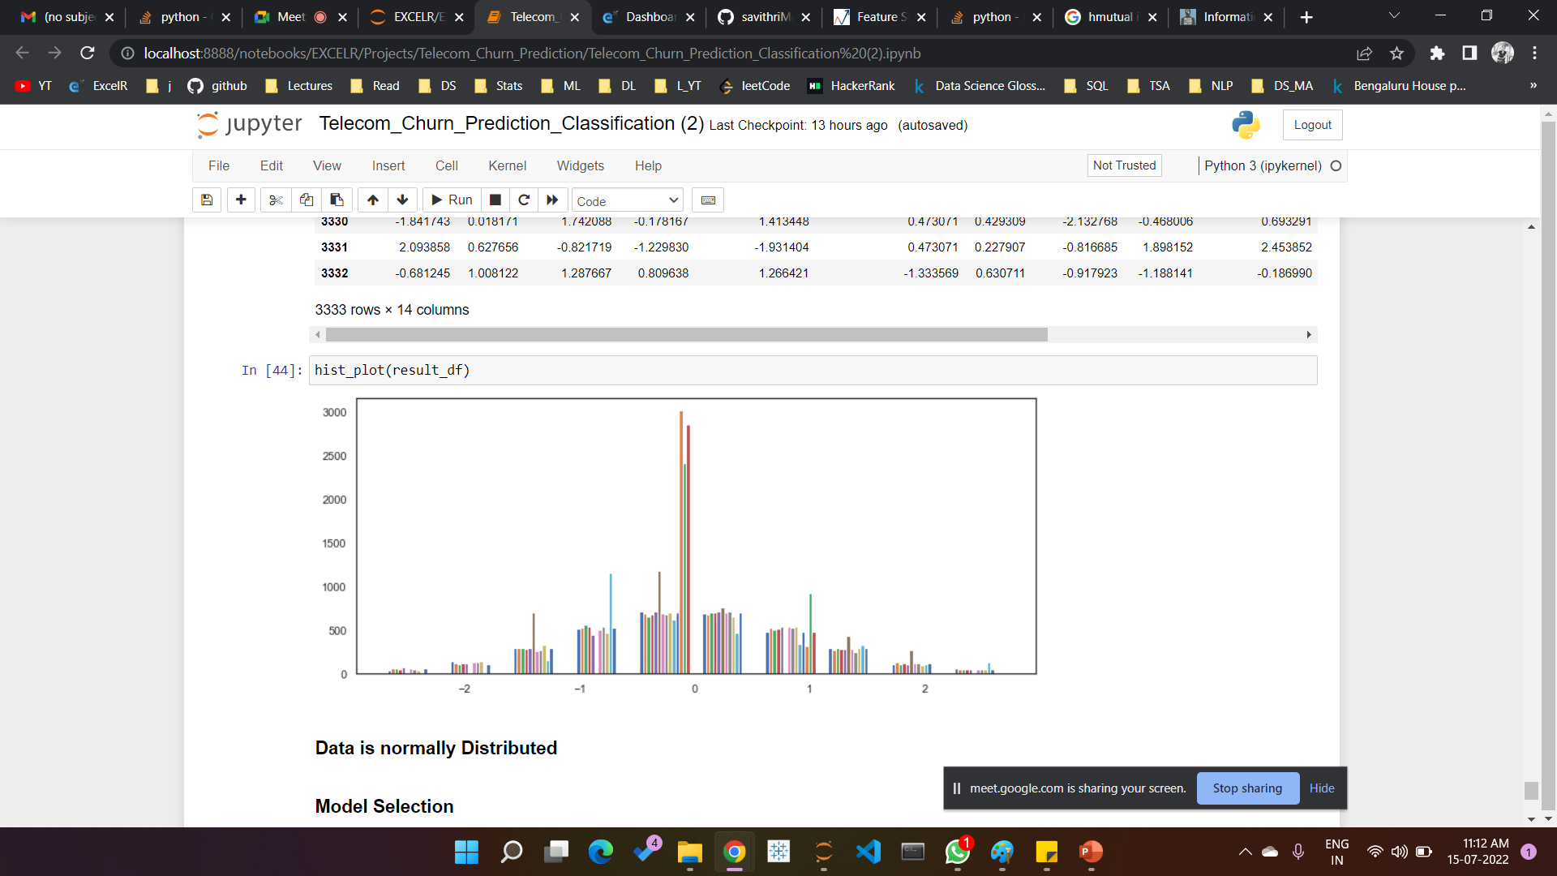
Standardization
Data is scaled

Slide 17
Model Selection
As the Data is Scaled, we will be therefore testing the accuracy of below models:
1. Logistic Regression
2. Random Forest Classifier
3. Decision Tree Classifier
4. XGBoost Classifier
5. KNeighbours Classifier
6. Naive Bayse Classifier
7. SVM Classifier
We are splitting the dataset into training and testing data in test size of 20% and training size of 80%
X_train.shape | (2666, 9)
X_test.shape | (667, 9)
y_train.shape | (2666,)
y_test.shape | (667,)

Slide 18
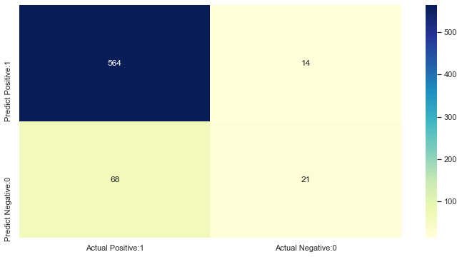
Logistic Regression
 | precision | recall | f1-score | support
0 | 0.89 | 0.98 | 0.93 | 578
1 | 0.6 | 0.24 | 0.34 | 89
accuracy |  |  | 0.88 | 667
macro avg | 0.75 | 0.61 | 0.64 | 667
weighted avg | 0.85 | 0.88 | 0.85 | 667
TP
FP-Type 1 error
Logistic Regression accuracy score with all the features: 0.8771
TN
FN-Type 2 error

Slide 19
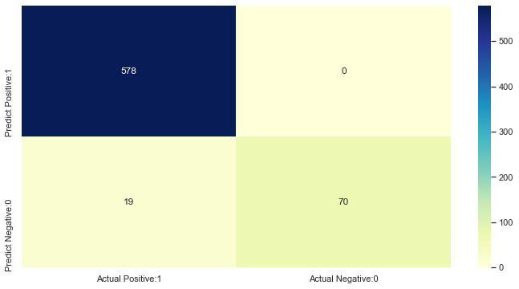

Random Forest Classifier
 | precision | recall | f1-score | support
0 | 0.97 | 1 | 0.98 | 578
1 | 1 | 0.79 | 0.88 | 89
accuracy |  |  | 0.97 | 667
macro avg | 0.98 | 0.89 | 0.93 | 667
weighted avg | 0.97 | 0.97 | 0.97 | 667

Slide 20
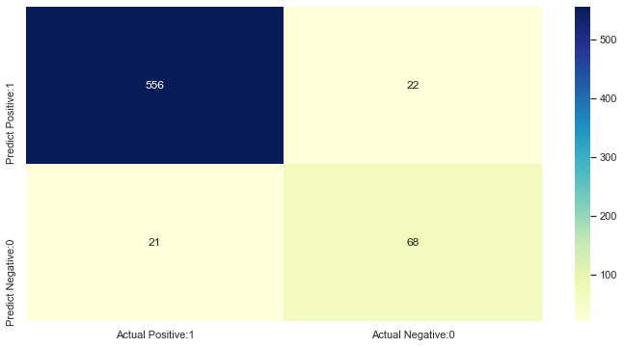
Decision Tree Classifier
 | precision | recall | f1-score | support
0 | 0.96 | 0.96 | 0.96 | 578
1 | 0.76 | 0.76 | 0.76 | 89
accuracy |  |  | 0.94 | 667
macro avg | 0.86 | 0.86 | 0.86 | 667
weighted avg | 0.94 | 0.94 | 0.94 | 667
Decision Tree Classifier accuracy score with all the features: 0.9355

Slide 21

XGBOOST Classifier
 | precision | recall | f1-score | support
0 | 0.97 | 0.99 | 0.98 | 578
1 | 0.96 | 0.8 | 0.87 | 89
accuracy |  |  | 0.97 | 667
macro avg | 0.96 | 0.9 | 0.93 | 667
weighted avg | 0.97 | 0.97 | 0.97 | 667
XGBoost Classifier accuracy score with all the features: 0.9685

Slide 22
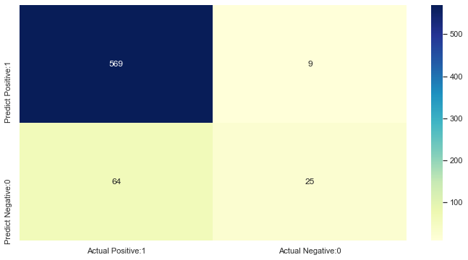
Kneighbors Classifier
 | precision | recall | f1-score | support
0 | 0.9 | 0.98 | 0.94 | 578
1 | 0.74 | 0.28 | 0.41 | 89
accuracy |  |  | 0.89 | 667
macro avg | 0.82 | 0.63 | 0.67 | 667
weighted avg | 0.88 | 0.89 | 0.87 | 667
KNeighbours Classifiers accuracy score with all the features: 0.8906

Slide 23
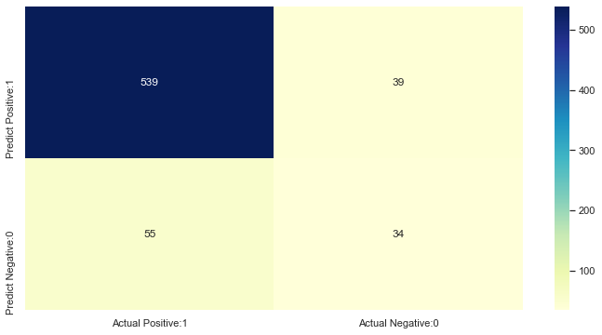
Naive Bayes Classifiers
 | precision | recall | f1-score | support
0 | 0.91 | 0.93 | 0.92 | 578
1 | 0.47 | 0.38 | 0.42 | 89
accuracy |  |  | 0.86 | 667
macro avg | 0.69 | 0.66 | 0.67 | 667
weighted avg | 0.85 | 0.86 | 0.85 | 667
Naive Bayes Classifiers accuracy score with all the features: 0.8591

Slide 24

SVM Classifier
 | precision | recall | f1-score | support
0 | 0.9 | 0.98 | 0.94 | 578
1 | 0.76 | 0.31 | 0.44 | 89
accuracy |  |  | 0.9 | 667
macro avg | 0.83 | 0.65 | 0.69 | 667
weighted avg | 0.88 | 0.9 | 0.88 | 667
SVM Classifiers accuracy score with all the features: 0.8951

Slide 25
Model wise score comparison
Comparing Precision,Recall,F1 score and ROC_AUC scores, we have selected Random Forest Classier for preparing the final model

Slide 26
Model Prediction
Sample data fed to the model
Predicted probabilities for each case
Example

Slide 27
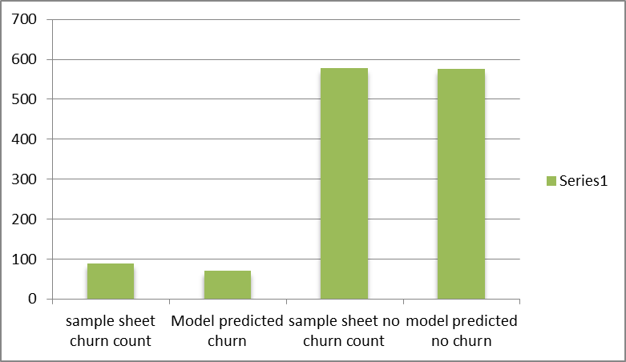
Model Results
Sample data output vs model generated output
sample sheet churn count | 89
Model predicted churn | 70
sample sheet no churn count | 578
model predicted no churn | 576

Slide 28
Model Deployment using Streamlit
We have observed that certain conditions are influencing customer-churn, for e.g.:
When the total charge is high, customer-churn is high.
When the customer is subscribing to International plan, the churn is high.
When no of customer service calls are high, churn is high.
Keeping in mind these conditions we have fed some data into the model and the prediction is as below:

Slide 29
Challenges faced and how we overcame
There are a total of 18 independent variables in the dataset. We found too many outliers in the
Numerical columns. So basically we employed IQR method to find the outliers for every column
Vis-à-vis churn. That helped us treating the outliers.
Secondly Multicollinearity issue posed some problem, but then we removed them using VIF scores.

Slide 30
Thank You

